Slide 1
All.Can at
European Health Forum Gastein
All.Can
Changing cancer care together
Patient insights for sustainable care –
improving efficiency in care for all
#PatientInsights
Thursday, 4 October 2018
9.00–11.30

Slide 2
Welcome address
Lieve Wierinck, MEP
Kathy Oliver, chair of the session
#PatientInsights

Slide 3
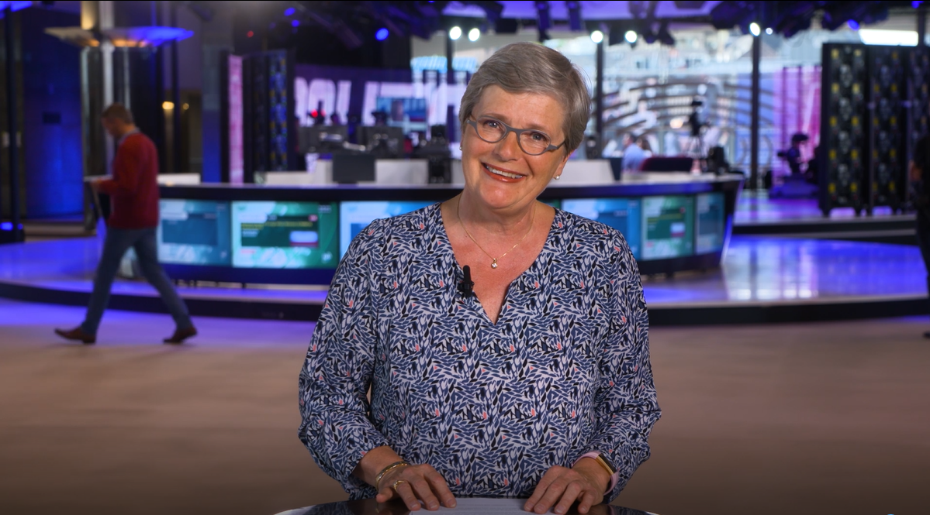
Welcome address, Lieve Wierinck MEP
Notes:
https://vimeo.com/289465328/953e4f013a

Slide 4
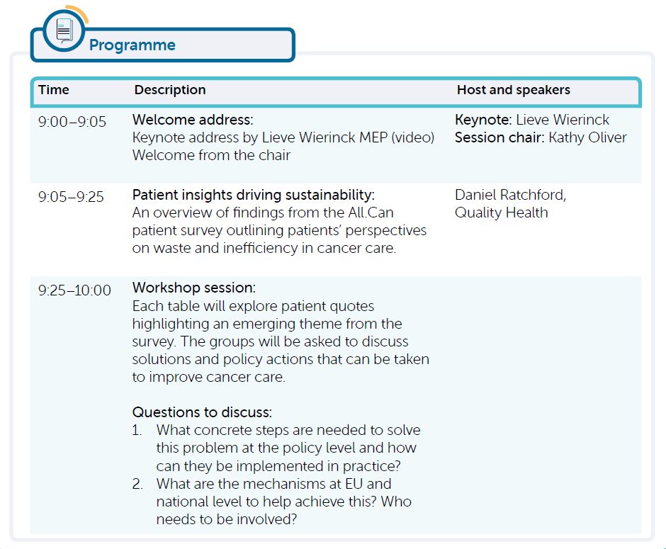
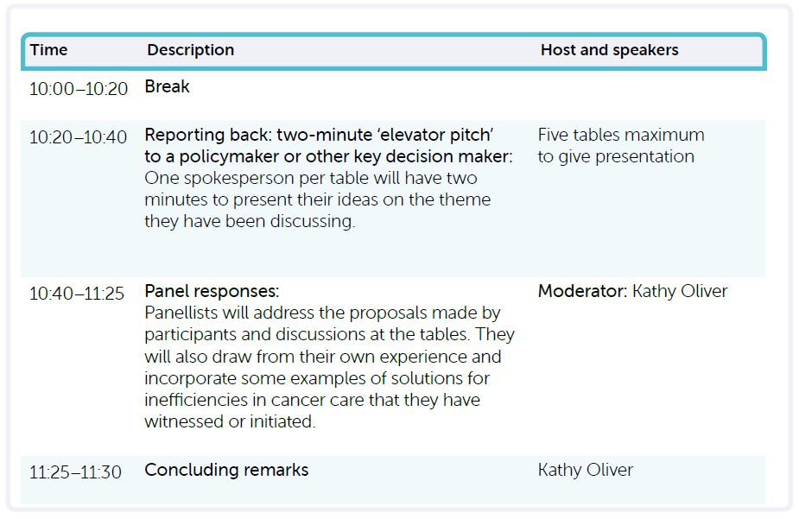

Slide 5

















All.Can is an international, multi-stakeholder initiative committed to improving efficiency in cancer care
‘It's very important to work together when we are dealing with an area like cancer.
There’s no single specialty
that can do everything.’
Matti Aapro, ECCO and
Member of All.Can

Slide 6

We need to redefine efficiency based on what matters to patients
‘Every euro, every penny not spent on improving outcomes for patients is money wasted.’
Vivek Muthu, Member of All.Can
Inefficiency is any aspect of
cancer care that is not focused
on what matters to patients.

Slide 7


Simple solutions can make a real difference to patients and their families

Slide 8
Patient insights driving sustainability
Daniel Ratchford, Quality Health

Slide 9
The All.Can patient survey – helping improve the efficiency of cancer care
A large-scale international patient survey focused on waste and inefficiency
Current and former patients with any type of cancer and their caregivers
A survey in 10 individual countries with the goal to achieve 300–400 responses per country
Plus a more generic international version for the rest of the world
Online survey here: http://patientsurvey.all-can.org/
Led by Quality Health – known for the National Cancer Patient Experience Survey
in the UK and internationally
Accompanied by an international literature review and in-depth patient interviews
A rigorous step-by-step process for questionnaire development and distribution
Final results will be published internationally, and in each country
Launch at the European Parliament on 7 February 2019

Slide 10

Real quotes collected in the All.Can patient survey
Notes:
https://vimeo.com/292669223/4f1e532e76

Slide 11
Interim findings
Where does inefficiency occur most for patients?
‘During the whole of your cancer care
and treatment, where do you feel there was most inefficiency?’
PLEASE NOTE: interim findings only
Canada |  | Poland |  | UK
My initial cancer diagnosis | 25% | Dealing with ongoing side effects | 26% | My initial cancer diagnosis | 36%
Dealing with ongoing side effects | 17% | Dealing with psychological impacts | 19% | Dealing with ongoing side effects | 18%
Dealing with psychological impacts | 15% | My initial cancer diagnosis | 15% | Dealing with psychological impacts | 17%
Dealing with the financial impacts | 14% | Getting the right treatment for my cancer | 14% | Opportunity to take part in clinical trials | 5%
Getting the right treatment for my cancer | 9% | Dealing with the financial implications | 11% | Access to patient support groups | 5%
Access to patient support groups | 7% | Opportunity to take part in clinical trials | 8% | Getting the right treatment for my cancer | 4%
Opportunity to take part in clinical trials | 5% | Access to patient support groups | 4% | Dealing with the financial impacts | 4%
Other | 8% | Other | 3% | Other | 10%
PLEASE NOTE: Interim findings only.

Slide 12
Interim findings
Diagnosis
Many patients point out inefficiencies in the time taken to see their doctor, referral for diagnosis, waiting for test results, inaccurate diagnoses, and waiting for treatment to start
From first visiting a doctor about the health problem caused by their cancer, to being diagnosed, most patients were diagnosed within three months – many within one month
For many patients, their cancer was diagnosed as something different: either once, or a number of times
Even after diagnosis, many patients waited a long time for treatment to start – for many, more than two months

Slide 13
Interim findings
Lack of psychological support
Lack of effective psychological support at every stage of their cancer pathway appears to be a major issue for many respondents – both for themselves and their families
At least two-thirds of respondents in each country said that they needed some form of psychological support throughout their cancer care
Of those who said they needed it, at least one-third said it was unavailable
For those who were able to have this support, the majority said that it was useful, although this varies significantly between countries

Slide 14
Interim findings
Time and timing
Organising the time needed for ongoing cancer treatment is a significant task for patients, and many point out frustrations and inefficiencies in how it is managed
For many patients, the entire process of arranging, confirming and changing appointments is still carried out on paper, and by post
Arranging, and paying for, transport to hospital for treatment is a major issue
Asked about cancelled appointments, around one-third of respondents said that the hospital/clinic had done this at least once. This is more than double the number of patients who said that they had to cancel appointments for some reason themselves

Slide 15
Interim findings
Financial toxicity
The financial implications of cancer care and treatment are significant for many patients, and vary a lot between different countries
Differences in health policy and health insurance mean that cancer patients pay for varying amounts of their care and treatment in different healthcare systems
But there are other financial impacts that are just as important for many patients:
  Transport costs
  Childcare costs
  Loss of employment
  Purchase of additional medicines

Slide 16
Our goal: use patient insights to drive meaningful policy change
2017
building the international platform
2018
generating data
and evidence
2019–2021
driving policy change and implementation
Continued engagement with all stakeholders, insight gathering and communications

Slide 17
Workshop session

Slide 18
Work in tables: prepare your elevator pitch!
For 35 minutes,
please use the quotes on your table as a starting point to prepare
an elevator pitch to a key decision-maker.
  Key questions to address:
  What concrete steps are needed to solve this problem at the policy level and how can they be implemented in practice?
  What are the mechanisms at EU and national level to help achieve this? Who needs to be involved?
Use your time wisely: you only have 2 minutes to present!
Notes:
25 minutes

Slide 19
Coffee break
See you back at 10:20
#PatientInsights

Slide 20
Introduction to the panel
Dirk Van den Steen, Policy Officer,
DG SANTE, European Commission
Yolande Lievens,
European CanCer Organisation (ECCO)
Past-President of European Society for Radiotherapy and Oncology (ESTRO)
Stefan Gijssels,
Executive Director, EuropaColon
Zeger Vercouteren,
Vice President Government Affairs & Policy,
Johnson & Johnson EMEA
Xavier Franz, Director Government Affairs – Western Europe, Varian
Chaired by Kathy Oliver,
Co-Director and Chair, International Brain Tumour Alliance

Slide 21
The elevator pitch

Slide 22
Reactions from the panel
Dirk Van den Steen, Policy Officer,
DG SANTE, European Commission
Yolande Lievens,
European CanCer Organisation (ECCO)
Past-President of European Society for Radiotherapy and Oncology (ESTRO)
Stefan Gijssels,
Executive Director, EuropaColon
Zeger Vercouteren,
Vice President Government Affairs & Policy,
Johnson & Johnson EMEA
Xavier Franz, Director Government Affairs – Western Europe, Varian
Chaired by Kathy Oliver,
Co-Director and Chair, International Brain Tumour Alliance

Slide 23
Q&A

Slide 24
Concluding remarks
Kathy Oliver, Co-Director and Chair, International Brain Tumour Alliance

Slide 25
Our goal: patient-centred policy change
Patient data
converted to
Compelling evidence
used to drive
Meaningful change
in cancer care
All stakeholders
Entire cancer care pathway

Slide 26

Please help us reach our goal of 4000 respondents before the All.Can patient survey closes on 31 October!
Inefficiency is any aspect of
cancer care that is not focused
on what matters to patients.

Slide 27

Thank you for your attention
#PatientInsights
Contact:
secretariat@all-can.org
www.all-can.org
@AllCanGroup
@AllCanGroup

