Slide 1

Vaccines for all – leaving no one behind
#VaccinesForAll #EHFG2018
A life-course approach to vaccination: Delivering health
and wellbeing for all across all ages
October 2018

Slide 2
Session overview
Introduction and welcome | 9:00–9:25
Welcome
Suzanne Wait, The Health Policy Partnership
Perspective from the European Commission
John Ryan, European Commission
Perspective from the European Parliament
Karin Kadenbach, European Parliament
Taking a life-course approach to vaccination –
how does it meet SDGs?
Daphne Holt, Coalition for Life-course Immunisation (CLCI)

Slide 3
Session overview
Workshop | 9:25–11:25 (including break 10:25–10:45)
From concept to action plans, what do we need to succeed in practice?
Achieving sustainable behavioural change:
improving HPV vaccine uptake in Denmark
Emilie Karafillakis, London School of Hygiene & Tropical Medicine
Vaccination literacy in Europe’s patients
Nicola Bedlington, European Patients’ Forum
Immigration and vaccination: experience and lessons from the MiMi project in Germany
Ramazan Salman, Ethno-Medizinischen Zentrums
Healthcare professionals as vaccination advocates:
increasing coverage through complementary efforts
Jan De Belie, Pharmaceutical Group of the European Union
Close | 11:25–11:30
MSD and CLCI close the session

Slide 4
Perspective from the
European Commission
John Ryan
Director for public health, country knowledge and crisis management, European Commission

Slide 5
Perspective from the European Commission
John F Ryan
Director
Public health
European Commission
Gastein, Friday 5 October 2018

Slide 6

Sustainable Development Goals
The EU fights the challenges linked to antimicrobial resistance which could cause more than 10 million deaths per year by 2050.
The European Commission has reinforced its commitment to end by 2030 the epidemics of AIDS, tuberculosis and malaria.
The EU Health Security Framework coordinates preparedness and response to serious cross-border health threats like pandemics.
The EU supports Member States to increase vaccination coverage and sustainability of national vaccination programmes.

Slide 7
EU legislation on communicable diseases
Decision No 1082/2013/EU on serious cross-border threats to health
Regulation (EC) No 851/200417 (ECDC founding act)
Commission Decision 2000/96/EC (list of communicable diseases)
Commission Decision 2002/253/EC (case definitions for communicable diseases)

Slide 8
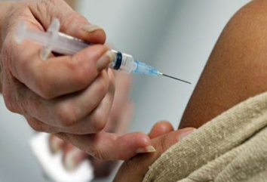
Commission´s work on vaccination
Coordination of preparedness,
assessment and outbreak
management of vaccine-preventable
Diseases
Guidance on communication activities in relation to vaccination programmes
Monitoring benefits and risks to develop and disseminate evidence-based information on effectiveness and safety of vaccines/vaccination
Organising for the first time a joint procurement for pandemic vaccines, and other products

Slide 9

EU policy initiative on vaccination
Proposal for a Council Recommendation and Commission Communication to strengthen the EU cooperation on vaccine-preventable diseases
Including life-course approach to vaccination
in vaccination plans
EU Joint Action on Vaccination
Taking into account research requirements for life-course vaccination

Slide 10
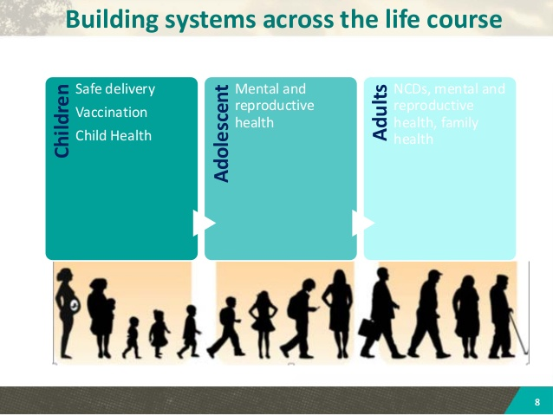
Importance of life course vaccination
Life-course vaccination maximises
Benefits of vaccination for
individuals, public health and society.
Life-course vaccination requires political leadership, changing public perception of vaccination, engagement of healthcare professionals, integration of non-healthcare settings and improved surveillance.
Promotion of life-course vaccination has to be evidence-based.

Slide 11
New financial period from 2021
European Social Fund + health strand - 413 m € over 7 years;
European Social Fund + shared management (€ 100 billion) will also have funding opportunities for health
Horizon Europe programme health cluster; 7.7B € over 7 years "health through the life-course; environmental and social health determinants.
ESF+ health strand managed by DG Health and food safety. Horizon Europe health cluster co-managed by DG health and food safety

Slide 12
New political environment
2019 will mark change in Commission
2019 will see European Parliament elections
Opportunity to fix new policy priorities in public health

Slide 13
Thank you!

Slide 14
Perspective from the
European Commission
Karin Kadenbach
Member of the
European Parliament,
The Progressive Alliance
of Socialists and Democrats

Slide 15
Life-course vaccination
Helping to achieve the sustainable development goals (SDGs)
Daphne E Holt
Chair, The Coalition for Life-course Immunisation

Slide 16
Life-course immunisation (LCI): what does it mean?
Vaccines are not just for children
Essential at all ages and stages of life
  Babies and children
  Adolescents
  Pregnant women
  New parents
  The immunocompromised
  Adults in the workplace
  Those with chronic diseases
  Older adults
  Travellers

Slide 17
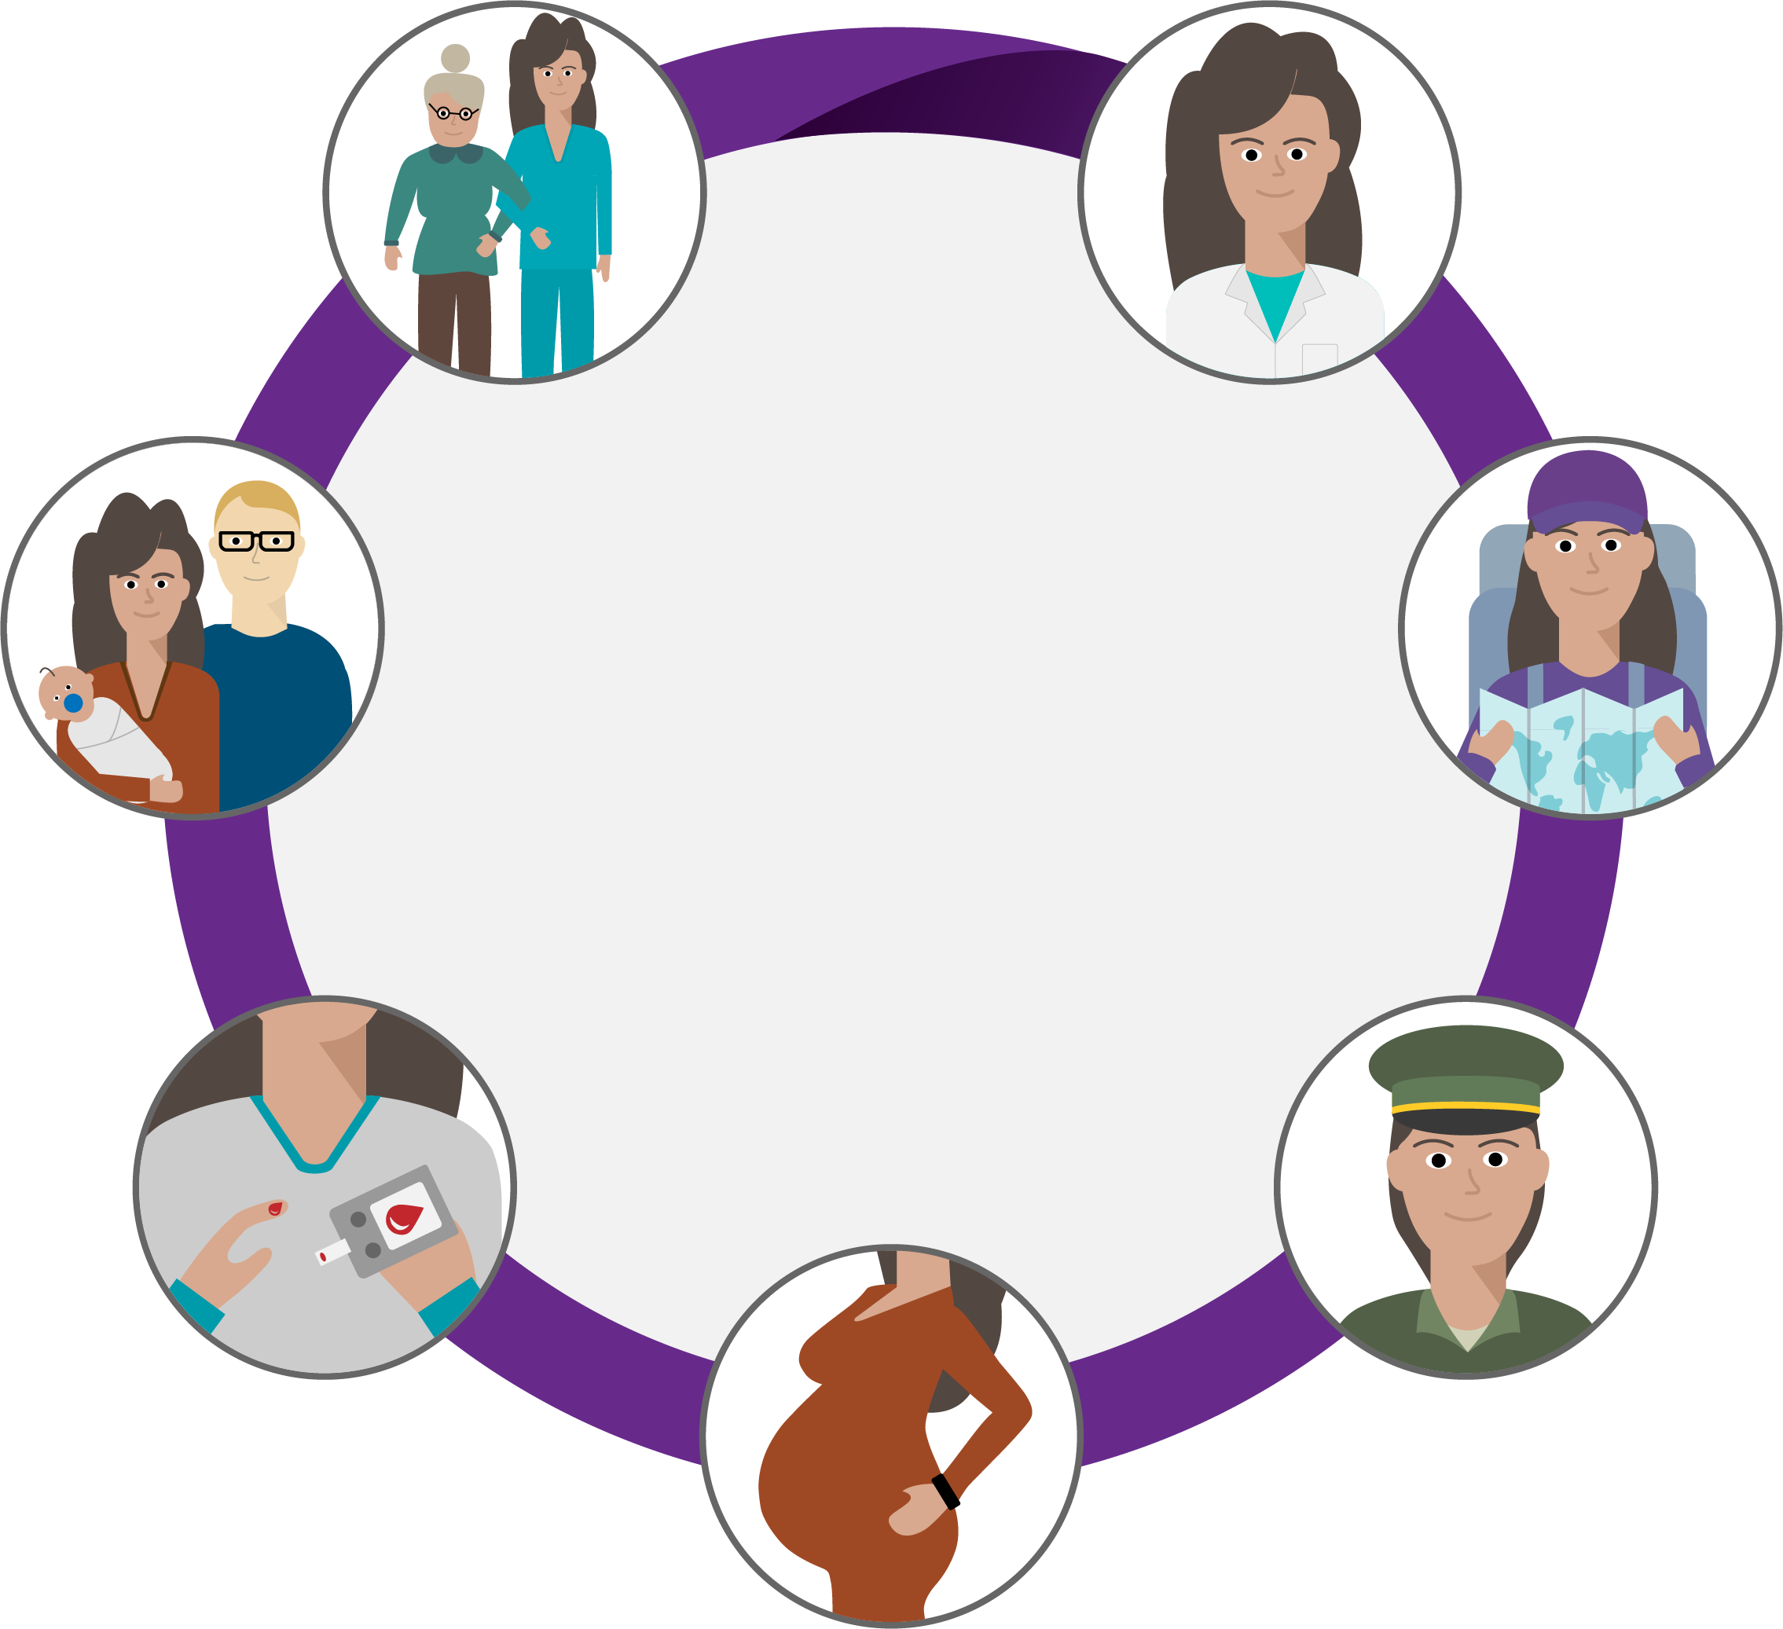
Life-course immunisation (LCI): what does it mean?
Different aspects of your life may put you at higher risk of catching and spreading infection, such as your job, whether you’re travelling abroad, becoming a parent or if you have certain medical conditions

Slide 18
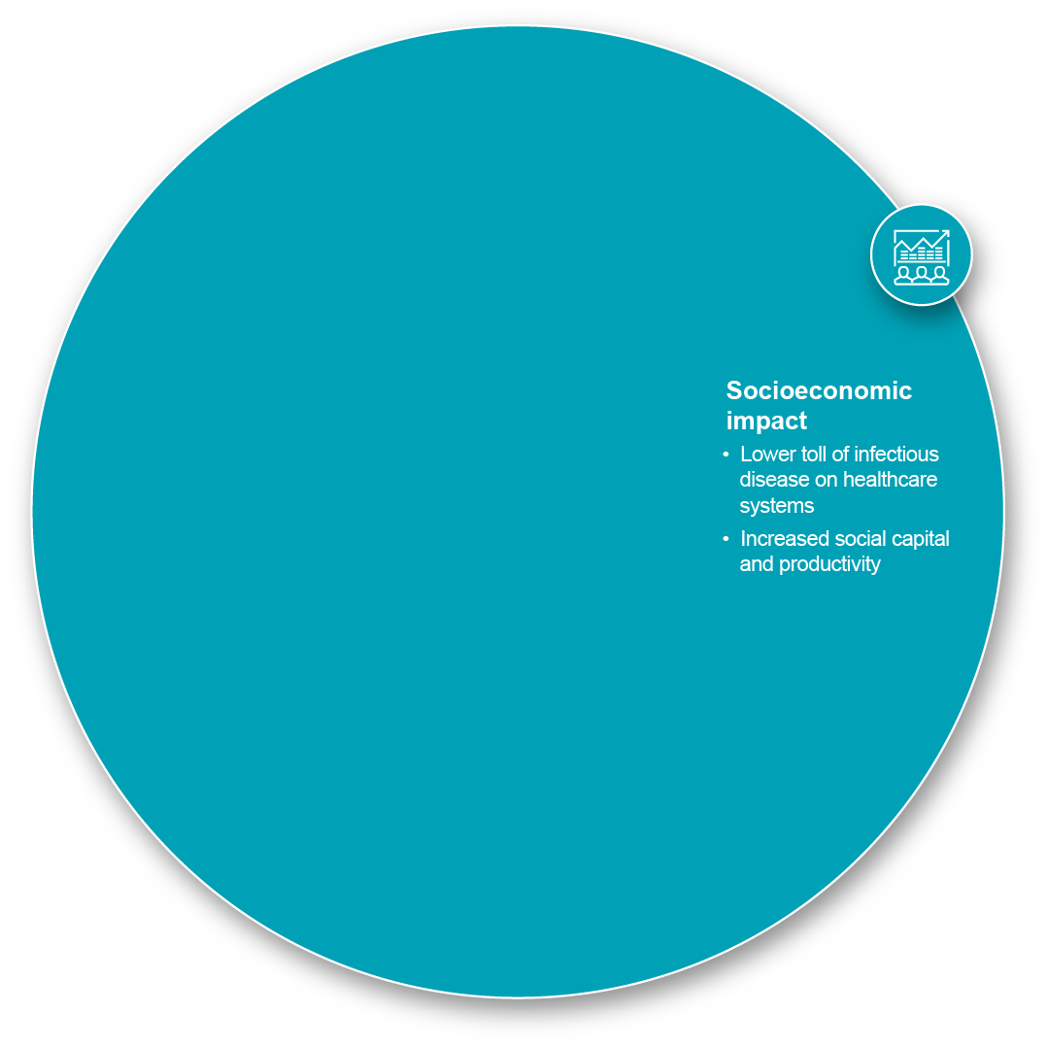
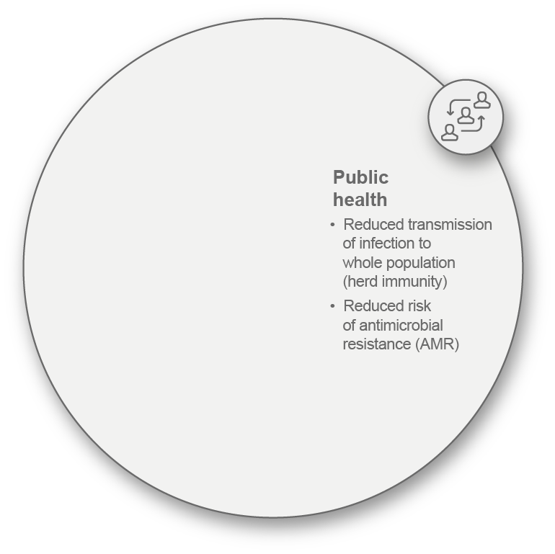
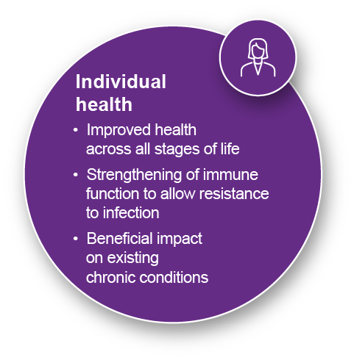
What are the benefits?

Slide 19
Ethos of the SDGs
‘Leaving no one behind’
Imperative – leave no one behind
SDGs laid out by the UN in 2005
Universal call to action to:
  End poverty
  Protect the planet
  Ensure all people enjoy peace and prosperity

Slide 20





Slide 21

Who can/is moving these concepts forward in Europe?
Politicians
and
policymakers
Civil
society
Healthcare professionals
Patient groups and other organisations
Business
The Coalition for Life-course Immunisation (CLCI)

Slide 22
The role of business
The private sector – a leading role in translating goals into actions and outcomes.
UN Global Compact – local networks in over 70 countries have mobilised the private sector to make the global goals local business
Platform for multi-stakeholder dialogue
  Help define public policy
  Foster ideas for innovation
  Mobilise financial resources

Slide 23
Role of the Coalition for
Life-course Immunisation (CLCI)
SDG #17: Innovative partnerships – major tenant for CLCI is that all stakeholders must be around the table
CLCI is a newly formed organisation based in the UK with 14 members from six European countries
Members – experts, associations from civil society, representing public health, patients, health NGOs, advocacy groups, academics and health professionals
CLCI is committed to prevention of infectious diseases over the life‐course through the promotion of the health and economic benefits of wide-scale immunisation by awareness-raising and advocacy
Join us

Slide 24
From concept to action plans, what do we need to succeed in practice?
WORKSHOP

Slide 25
Case study
  Achieving sustainable behavioural change: improving HPV vaccine uptake in Denmark
  Emilie Karafillakis
  The Vaccine Confidence Project,
  London School of Hygiene
  & Tropical Medicine

Slide 26
Case study
  Vaccination literacy
  for Europe’s patients
  Nicola Bedlington
  European Patients’ Forum

Slide 27
Case study
  Immigration and vaccination: experience and lessons from
  the MiMi project in Germany
  Ramazan Salman
  Ethno-Medizinischen Zentrums

Slide 28
Case study
  Healthcare professionals as vaccination advocates: increasing coverage through complementary efforts
  Jan De Belie
  Pharmaceutical Group
  of the European Union

Slide 29
Group discussion
  Please split into four groups by merging
  tables together

Slide 30
Group discussion
1
What countries are represented in this group?
2
What would be key barriers to implementation
of the presented example in each country?
3
What would be key enablers to implementation?
4
How would you convince people
who are sceptical?
5
How would you measure success?

Slide 31
BREAK
  Please be back
  promptly

Slide 32
Welcome back!
Reporting back from each group
1
What countries are represented in this group?
2
What would be key barriers to implementation
of the presented example in each country?
3
What would be key enablers to implementation?
4
How would you convince people
who are sceptical?
5
How would you measure success?

Slide 33
Q&A and group discussion
  What are the key actions that will lead to the practical implementation of a life-course approach to vaccination?
  Moderated by
  Suzanne Wait,
  The Health Policy Partnership

Slide 34
Closing comments
  Daphne Holt,
  CLCI
  and
  Sibilia Quilici,
  MSD

Slide 35
Thank you for your attention
#VaccinesForAll #EHFG2018
Please find the report http://www.comomeningitis.org/media/131769/life_course_vacc_policy_report_interactive-1-.pdf
The animation
https://vimeo.com/291658818
For more information, or to get a copy of the report, please contact: Jody Tate
jody.tate@hpolicy.com

